Slide 1
Austin .NET User Group
April 10 2017
Austin TX

Slide 2
Caching in Microsoft Azure
Shawn Weisfeld
Sr. Technical Evangelist
Microsoft

Slide 3
Agenda
Do you need cache?
Where can you cache?
Cache-Aside Design Pattern
Caching in the Browser
Caching with a CDN
Caching on the Web Server
Caching with a Distributed Cache

Slide 4








About Me
Shawn Weisfeld
Sr. Technical Evangelist
Microsoft – US Developer Experience
sweisfel@microsoft.com
Austin, TX

Slide 5
Are you an ISV looking to utilize the cloud?
An ISV is a company that sells software or services powered by software.
My team wants to help you on your cloud journey!
Work with an Azure Architect to provide guidance on your technical journey to the cloud.
Work with a Business Evangelist to access Microsoft resources to help get exposure for your solution and bring your solution to market.
For more information email
USmicrosoftISVteam@microsoft.com
Watch recorded & live webcasts
http://www.buildandscaleyourcloudapp.com

Slide 6


Watch User Group presentations for FREE online! We now have over 590 presentations online
Miss a User Group meeting?
Forget something that you learned?
Want to see content from a User Group not in your area?
Want to share with a buddy?
Presentations from the thought leaders on the topics you care about including:
Agile
Azure
C#
Entity Framework
HTML5
MVC
SQL
jQuery
and Much More!
We know you cannot make it to every session,
that is why we post them online for you!
New Content added all the time!
For new content announcements
@UserGroupTV
http://www.UserGroup.tv

Slide 7
Do you need cache?

Slide 8

Source: https://www.bluedogposters.com.au/img/01/01-1104_l.jpg

Slide 9
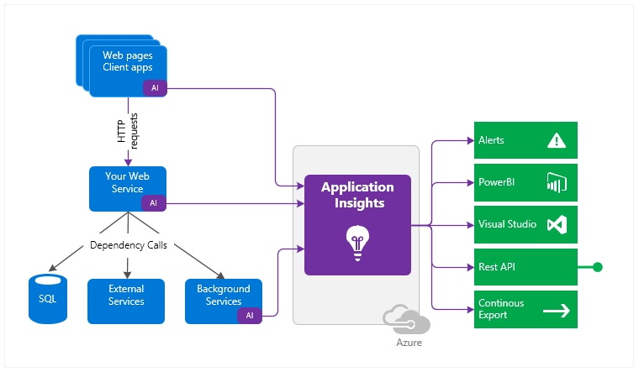
Application Insights

Slide 10
Where can you cache?

Slide 11
Typical Web Application
Data Store
Web Browser
Web Server

Slide 12
Cache in the browser
Data Store
Web Browser
Web Server

Slide 13
Caching with a CDN
Data Store
Web Browser
Web Server

Slide 14
Caching on the Web Server
Data Store
Web Browser
Web Server

Slide 15
Caching with a Distributed Cache
Data Store
Web Browser
Web Server

Slide 16
… not mutually exclusive
Data Store
Web Browser
Web Server

Slide 17
Cache-Aside Design Pattern

Slide 18
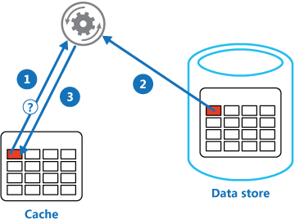
Cache-Aside Design Pattern
Is the item in the cache?
Yes, read the item from the cache, return to caller
No, get the item from data store, write it to the cache, return to caller
https://docs.microsoft.com/en-us/azure/architecture/patterns/cache-aside

Slide 19
Issues and considerations
Lifetime of cached data
Set exportation policy to evict stale data
Evicting data
When cache gets full older data is evicted
Priming the cache
Refresh cache with data you anticipate needing to reduce cache misses
Consistency
Update/Evict cache entries when data store changes
Local
Local caching vs. shared caching

Slide 20
Caching in the Browser

Slide 21
Cache in the browser
Data Store
Web Browser
Web Server

Slide 22
Demo

Slide 23
Cache-Control header
How & how long can the browser cache something
Client Side check

Slide 24
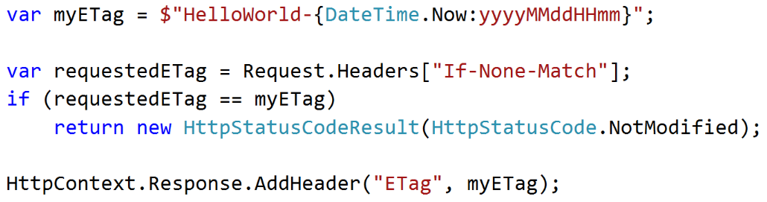
ETag header
Has the resource changed since last time
Round trip to server

Slide 25
NOTE: ASP.NET Helpers
OutputCache (Full Framework)
https://docs.microsoft.com/en-us/aspnet/mvc/overview/older-versions-1/controllers-and-routing/improving-performance-with-output-caching-cs
ResponseCache (.NET Core)
https://docs.microsoft.com/en-us/aspnet/core/performance/caching/response

Slide 26
Caching with a CDN

Slide 27
Caching with a CDN
Data Store
Web Browser
Web Server

Slide 28
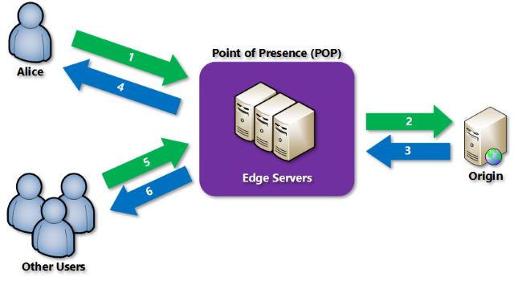
What is a CDN

Slide 29
Demo

Slide 30
Caching on the Web Server

Slide 31
Caching on the Web Server
Data Store
Web Browser
Web Server

Slide 32
Demo

Slide 33
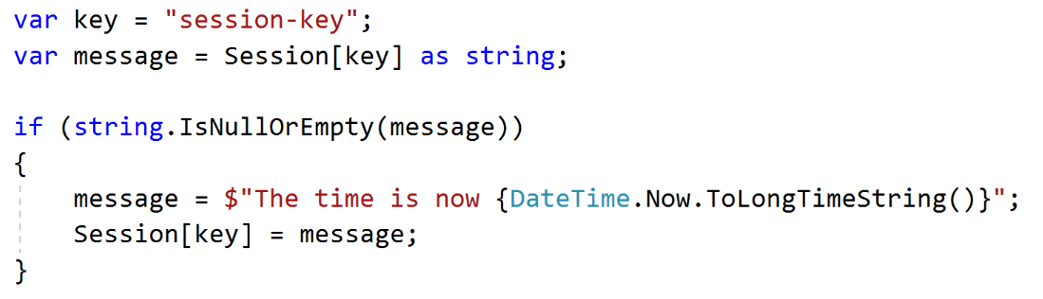
ASP.NET Session State

Slide 34
Caching with a Distributed Cache

Slide 35
Caching with a Distributed Cache
Data Store
Web Browser
Web Server

Slide 36
Wrap up

Slide 37
Call to Action
Instrument your application
Evaluate Caching options in Azure
Apply generously where approperate

Slide 38
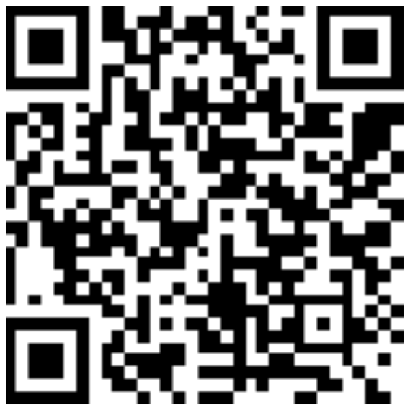
Thank you! Your Feedback is Important
Rate My Talk & Download Slides!
http://bit.ly/RateShawnsTalk
(case sensitive)
Contact Information
Email: sweisfel@microsoft.com
Blog: http://www.shawnweisfeld.com
Twitter: @shawnweisfeld

